Slide 1

AUTOMOBILE INDUSTRY
An Exploratory Data Analysis
Presented By:
Ashwani Anil Mittal

Slide 2


Inspiration
Automobile Industry grosses around $100 Billion a year.
Cars always keep evolving! So does the consumer’s needs.

Slide 3

TARGET AUDIENCE
Dealerships looking into stocking up their inventory.
Automobile Manufacturer looking to enter the US Car Market in 2022.

Slide 4


The Dataset
Sales Report Published by Cox Automotive.
Contains data of light-vehicles sold in the USA.
Develop solutions to create faster vehicle transactions, enabling consumers to have a seamless online-to-offline experience.
More about Cox Automotive:
https://www.coxautoinc.com/about-us/
Link to the Sales Report:
Sales Report Q3 2022 - COX AUTOMOTIVE

Slide 5
Challenges
Cleaning the Data.
Determining the Scope of the Analysis.
Sorting through the data.
Acclimatizing to the Tableau Interface.

Slide 6
Scope of analysis
Sales by the number of units sold.
Automobiles classified into segments.
Years: 2021 – 2022
Sales only in the USA.
Competition is segregated as Manufacturers rather than individual Brands.

Slide 7
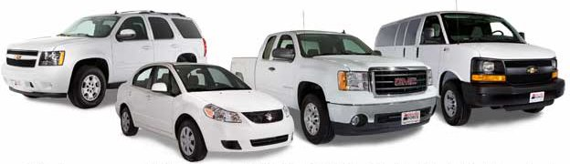
Automobile segments
VAN
TRUCK
SUV
CAR

Slide 8
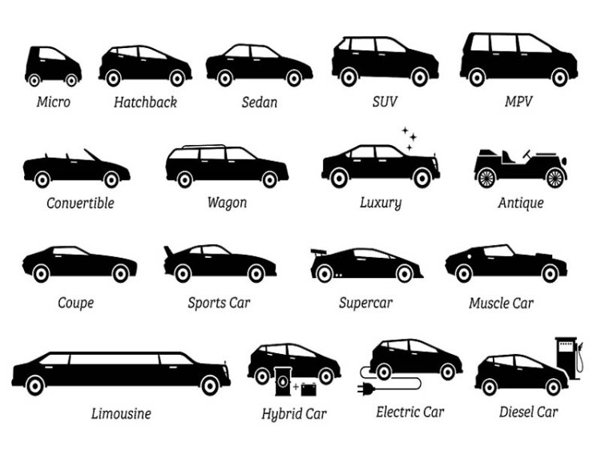
Automobile segments

Slide 9
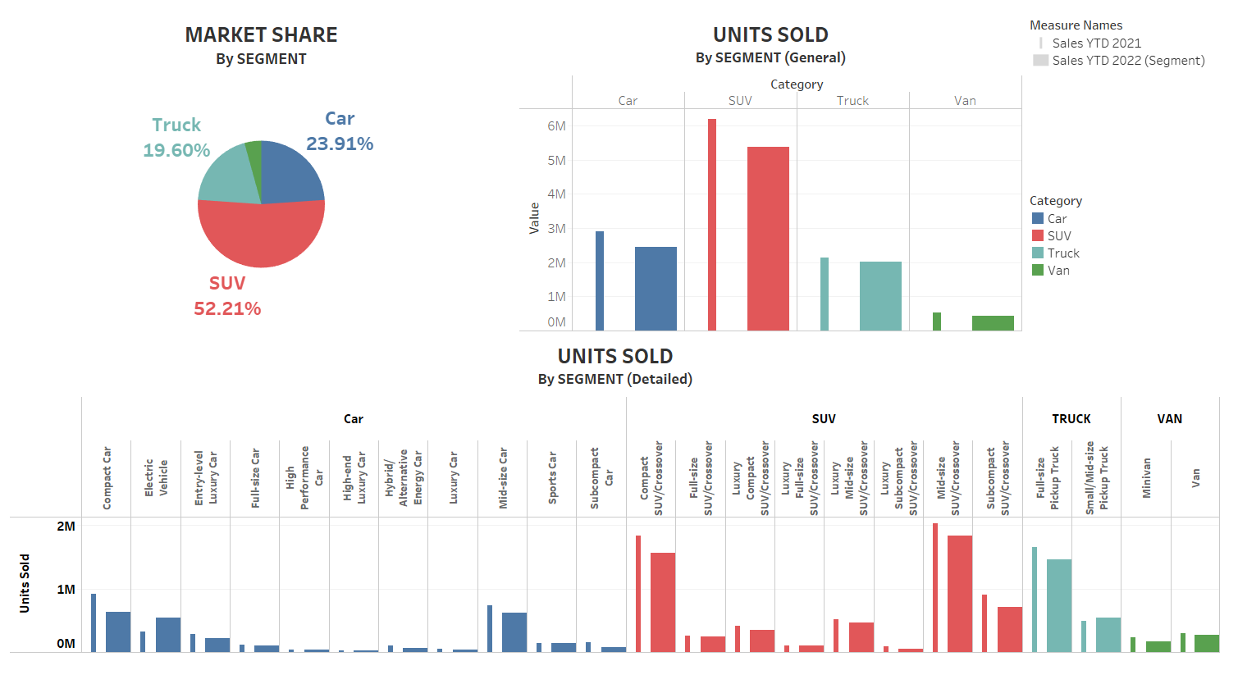
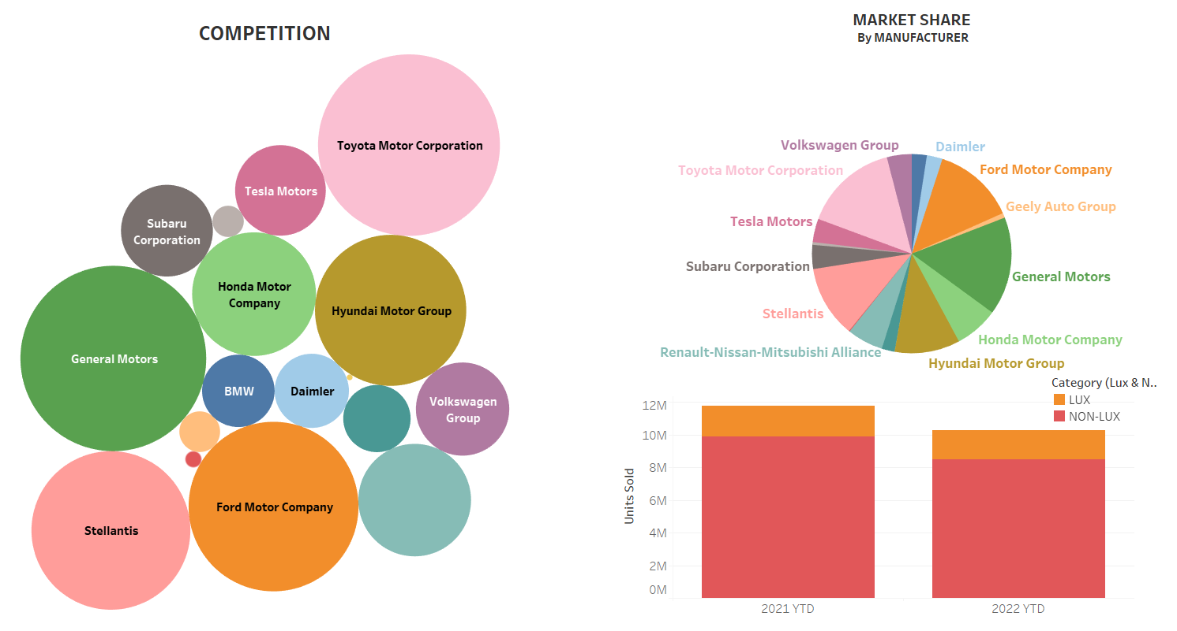
Key observations
Tableau Dashboards

Slide 10
KEY takeaways
SUV is the leading segment in terms of units sold, with over 50% of vehicles sold being SUV.
Top competitors with highest market share are:
General Motors
Toyota Motor Corporation
Ford Motor Company
Most units sold fall in the Non-Lux category.
A decline in sales compared to 2021 likely points to the reduced demand for vehicles likely due to the recession.
In contrast to other segments, Electric Vehicles sales significantly increased, nearly doubling in number of units sold.

Slide 11

Build on this
Sales for years 2018 – 2020 : To account for Covid-19.
Sales in Dollar($) figures.
Monthly & Quarterly Sales Reports by Region.
Manufacturer Segment-wise Reports.
Sales by Brands rather than Manufacturers.
A deeper dive by looking at individual models.

Slide 12
Thank You!
Any Questions?

